Slide 1

REGION DETECION USING VARIOUS SPEECH ACCENT
Accent Recognition and its
Application to Speech Recognition
-Manan Singhal
-Utkarsh Thakur

Slide 2
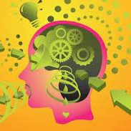

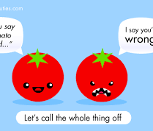
IDEOLOGY BEHIND THIS PROJECT
The idea behind this project was to create a design and train a model to differentiate between the Indian languages and relate them to their background.
Later expanding to other parts of the world
Understanding some of the major projects like Siri and Alexa
Can we increase our Security.

Slide 3
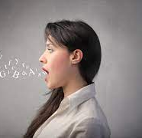
Why has we chosen this project??
it has potential to allow us to experiment with many parts of engineering discipline such as digital system.
Accent conversion (AC),
they had the accent of another speaker
(people feels similarity with each other)
An accent is defined to be a distinct mode of pronunciation of a language, especially one associated, with a particular nation, locality, or social class.
MACHINES MIGHT NOT MIND YOUR LANGUAGE ANYMORE.

Slide 4
Techniques/ Technologies used
● Python 3.0
● Jupyter Notebook
● Pandas
● Matplotlib ,joblib, pickle
● Librosa , keras,tenserflow,ski-learn
● Noice reduce
● Mlp classifier, svm classifier and CNN
● Confusion matrix
Some other basic data science knowledge

Slide 5
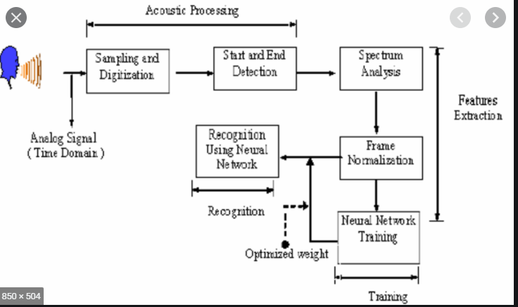
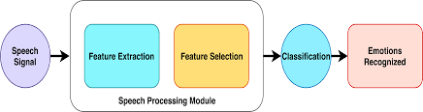
BASIC ANALOGY OF PROJECT
Methodology / Planning of Work
01 Exploratory Data Analysis and Cleaning
02 Using MLP Classifier, SVM and CNN Algorithms to accurately predict regions using speech action.
03 Collection, Representation, Proper documentation & Integration of Data & results found
04 Confusion Matrix for each & every algorithms for better future analysis & comparison
a
accent

Slide 6
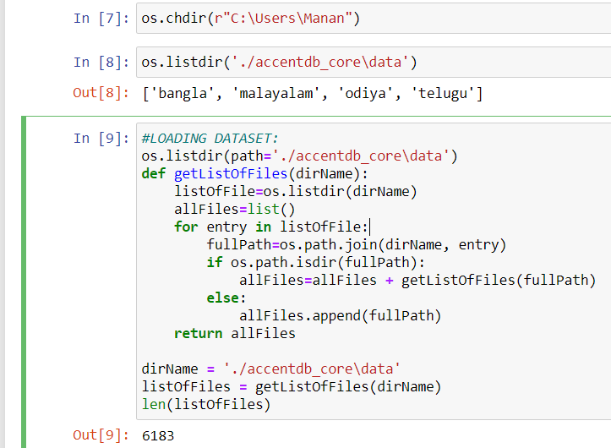
DATASET USED:
The dataset has been taken from Kaggle
Includes 6183 files with 7 speakers from 4 different accent( Odiya, Telugu , Malayalam and Bangla)

Slide 7
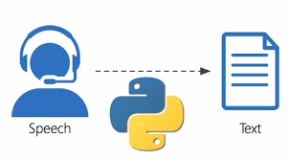
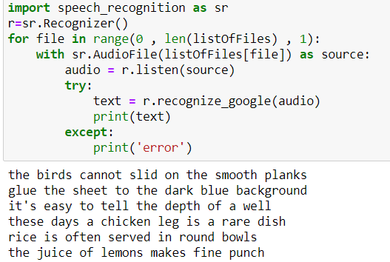
SPEECH TO TEXT USING SPEECH RECOGNITION API
Initially we analyzed the data with speech to text conversion and seeing is their any audio file that is not even a single bit understandable and see what all audio contains.
Why r we doing this???

Slide 8
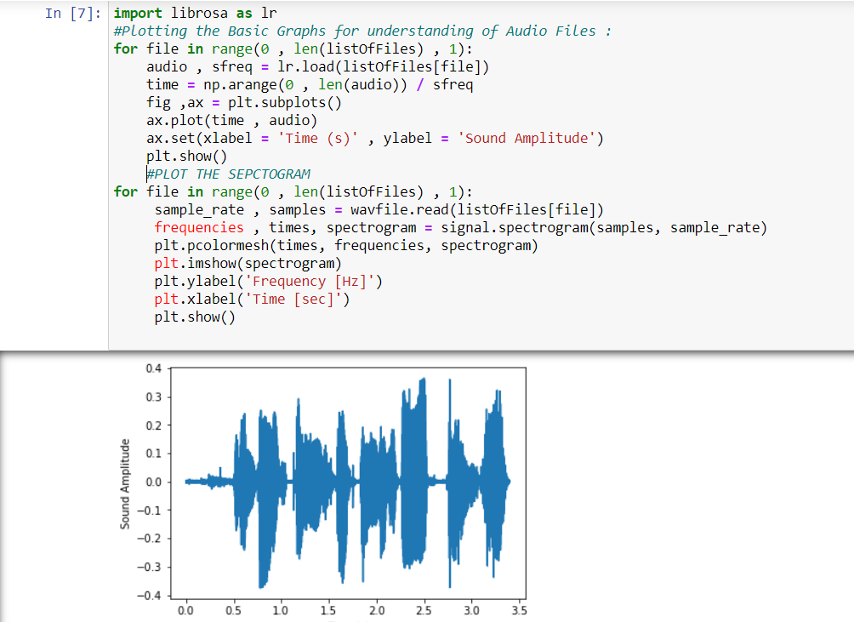
ANALYZING THE AUDIO SIGNAL BY plotting the graphs in waveform(basic spectrogram graphs were created)

Slide 9
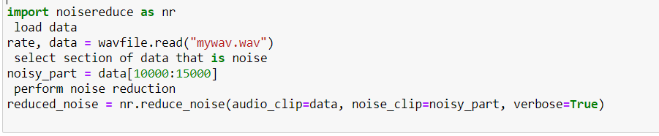
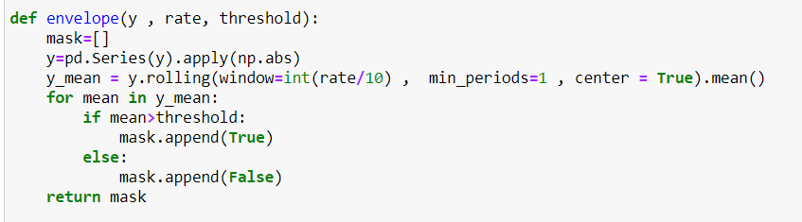
As with all unstructured data formats, audio data has a couple of preprocessing steps
Removing of unwanted noise around the raw audio file from background and lowering down the sample rate( For this, we simply take values after every specific time steps.
Noise reduction using noicereduce ( 10000:15000) library For example; in a 2 second audio file, we extract values at 1 second. This is called sampling of audio data, and the rate at which it is sampled is called the sampling rate.)
MASKING AND CLEANING of audio files

Slide 10
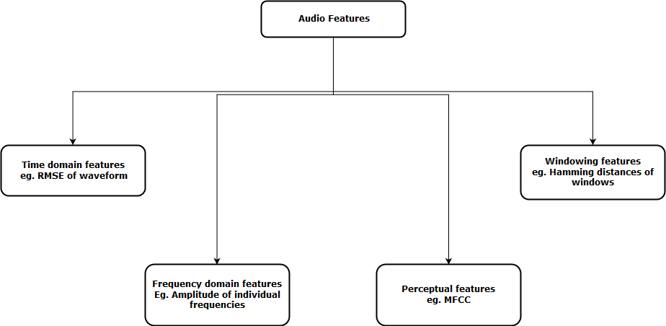
CENTRAL IDEA OF feature EXtraction
This steps involves extracting the features from the audio files will help our model to learn between these audio files.
For feature extraction we make use of the LIBROSA library of python , which is one of the libraries used for audio analysis
The audio data were first preprocessed into uniform length audio files, from which features (MFCCs they are representation of the short-term spectrum of sounds This process involved breaking down the audio clip into several windows and extracting the frequency information in each window.) were extracted.

Slide 11
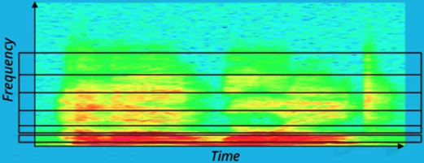
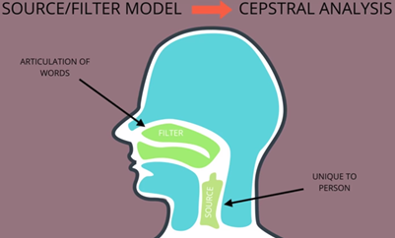
WHAT IS MFCC in simple terms with deeper dive??
Mel Frequency Cepstrum Coefficient Analysis is the reduction of an audio signal to essential speech component features using both Mel frequency analysis and Cepstral analysis. (12 -1 3 features out of 39 )
Mel Frequency Analysis
Only those frequencies humans can hear are important for recognizing speech.
Or
filter out sound that we can’t hear.
Cepstral Analysis
we drop the component of speech unique to individual vocal chords and preserving the shape of the sound made by the vocal tract(articulation words are here).

Slide 12
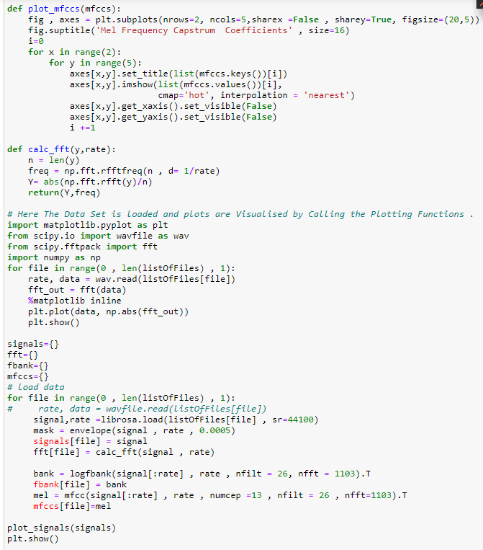
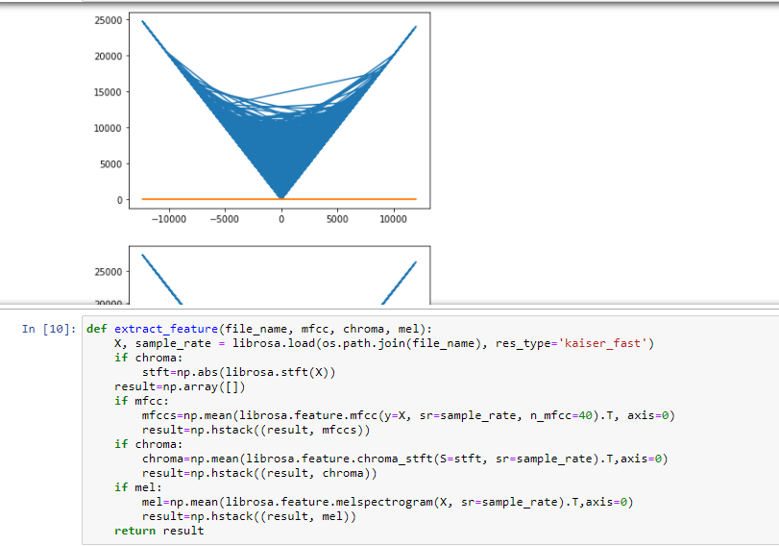

Slide 13
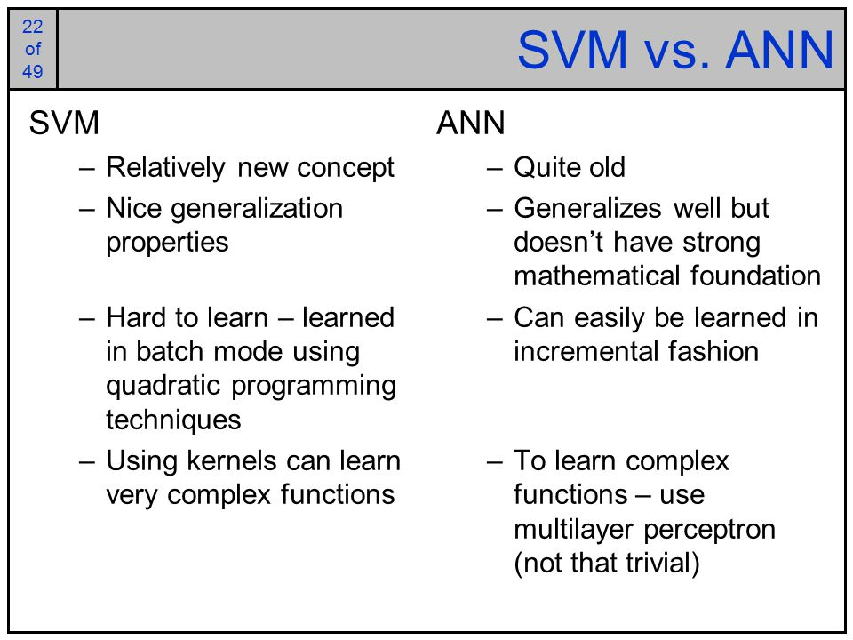
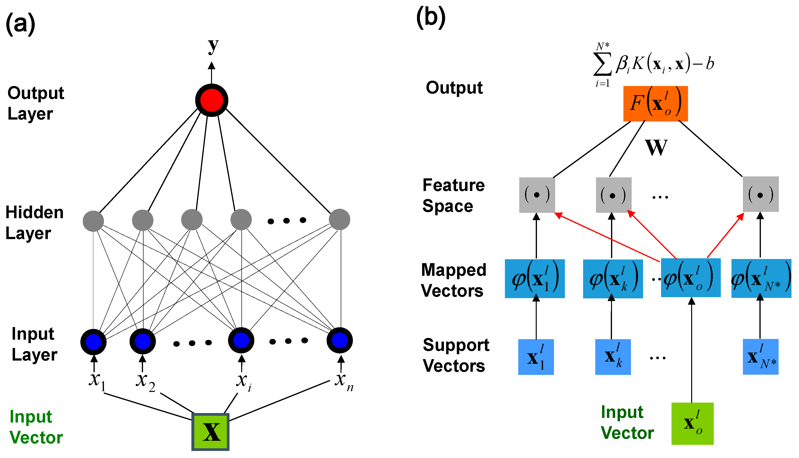
BUILDING THE MODEL
Since the project is a classification model, Multilayer Perceptron(ANN) , CNN and SVM seems the obvious choice. We chose this model to predict the right background of the speaker.

Slide 14
NOW LET’S SEE PREDICTION AND MOVING TOWARDS THE CODE PART OF EACH MODEL

Slide 15
MULTI LAYERED PERCEPTRON(MLP)
A multilayer perceptron (MLP) is a class of feedforward artificial neural network (ANN). ... MLP utilizes a supervised learning technique called backpropagation for training. Its multiple layers and non-linear activation distinguish MLP from a linear perceptron.
The "full connectivity" of these networks make them prone to overfitting data
When to Use Multilayer Perceptrons?
Multilayer Perceptrons, or MLPs for short, are the classical type of neural network.
They are comprised of one or more layers of neurons.
MLPs are suitable for classification prediction problems where inputs are assigned a class or label.
Other Use MLPs For:
Tabular datasets
Regression prediction problems

Slide 16
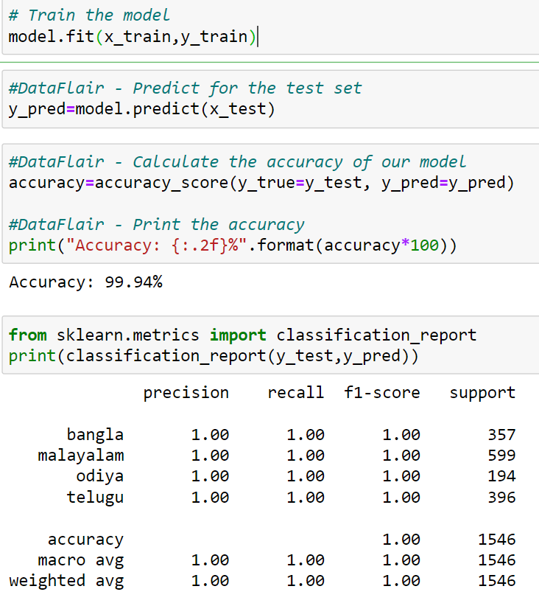
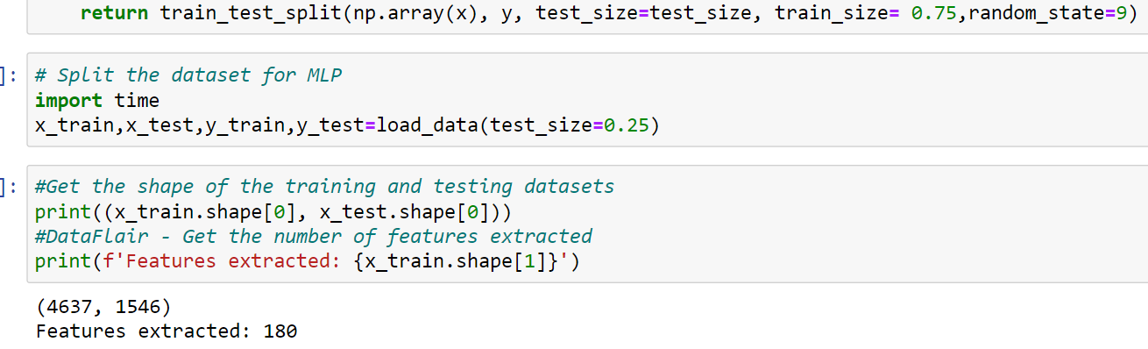
MLP SPLIT FIT AND CLASSIFICATION REPORT
Accuracy came out to be 99.94%

Slide 17
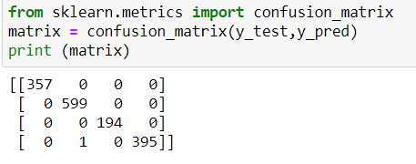
Confusion Matrix
A Confusion matrix is an N x N matrix used for evaluating the performance of a classification model, where N is the number of target classes. The matrix compares the actual target values with those predicted by the machine learning model. This gives us a holistic view of how well our classification model is performing and what kinds of errorsit is making.

Slide 18
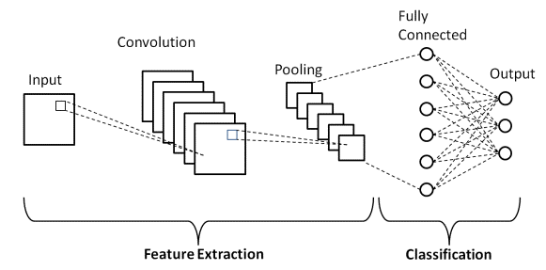
CNN(Convolutional neural network)
It uses a special technique called Convolution.
Now in mathematics convolution is a mathematical operation on two functions that produces a third function that expresses how the shape of one is modified by the other.
CNNs are regularized versions of multilayered perceptron
In deep learning, is a class of deep neural networks, most applied to analyze visual imagery and pattern recognition.
CNNs take a different approach towards regularization: they take advantage of the hierarchical pattern in data and assemble patterns of increasing complexity using smaller and simpler patterns embossed in their filters.
WITHOUT ANY LOSS IN FEATURE
Therefore, on a scale of connectivity and complexity, CNNs are on the lower extreme.

Slide 19
When to Use Convolutional Neural Networks?
Convolutional Neural Networks, or CNNs, were designed to map image data to an output variable.
They have proven so effective that they are the go-to method for any type of prediction problem involving image data as an input.
Although not specifically developed for non-image data, CNNs achieve state-of-the-art results on problems such as document classification used in sentiment analysis and related problems.
Use CNNs For:
Image data
Classification prediction problems
Regression prediction problems

Slide 20
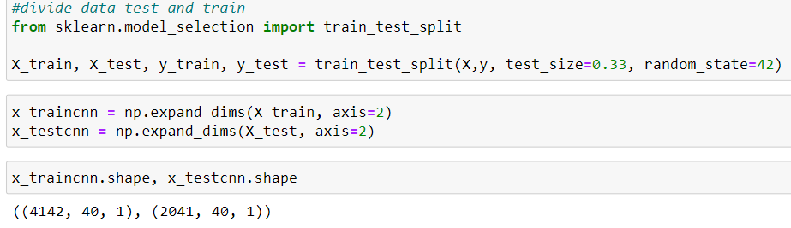
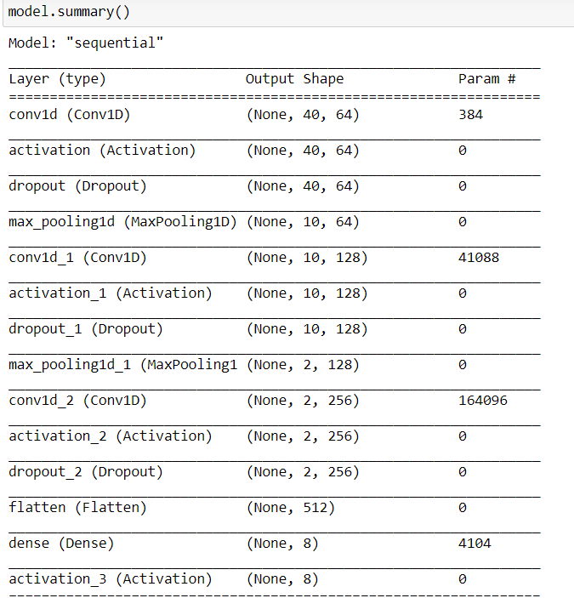
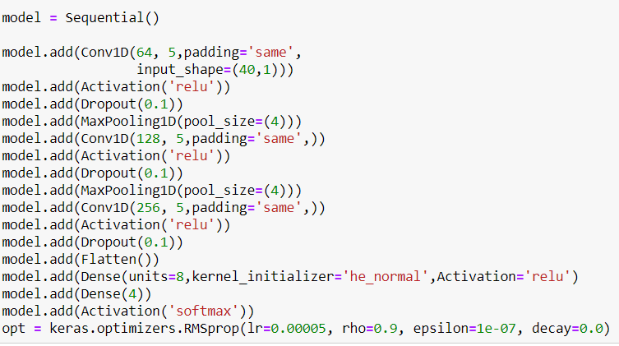
No. of classes=No. of neurons in last layer

Slide 21
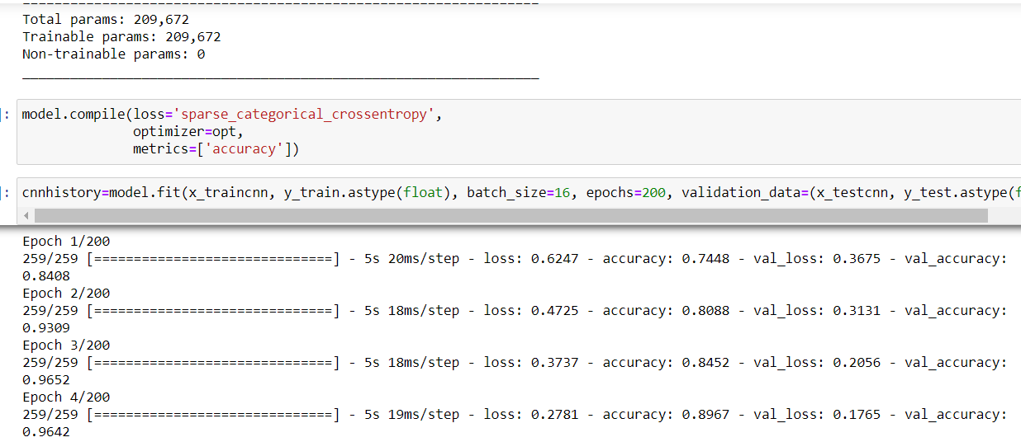
FIRST EPOCH with accuracy of 84.08%

Slide 22
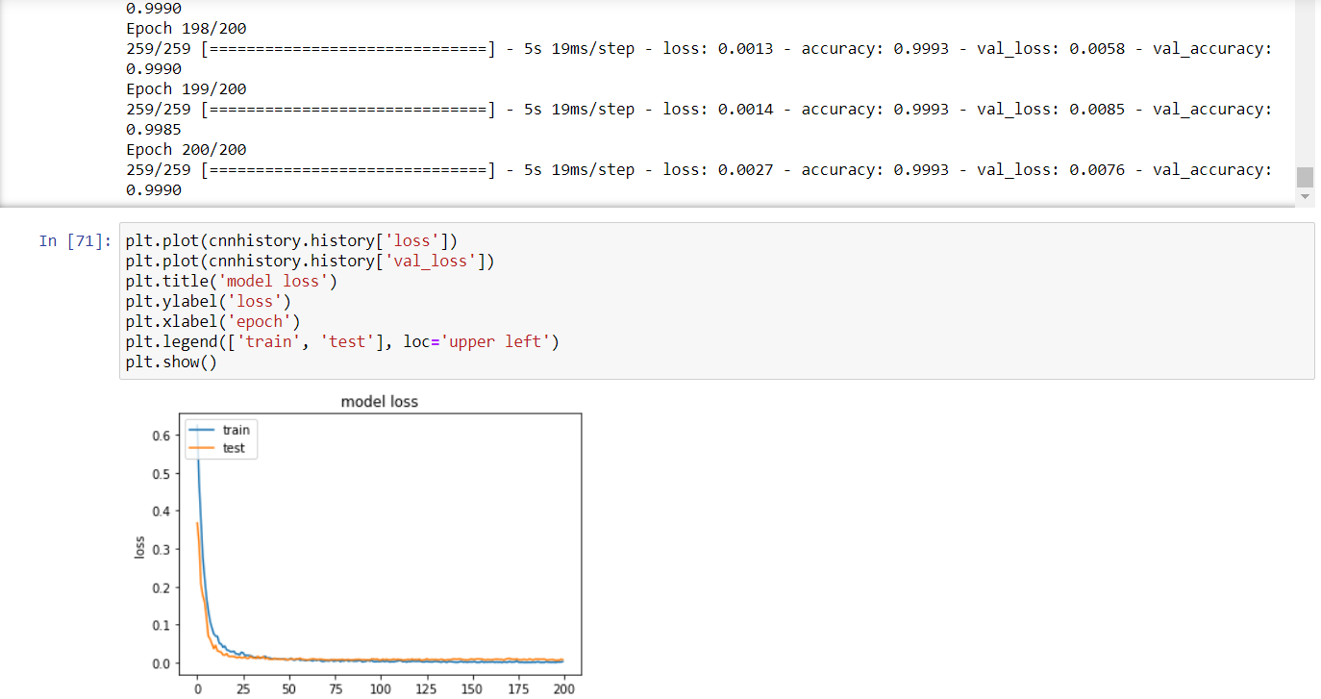
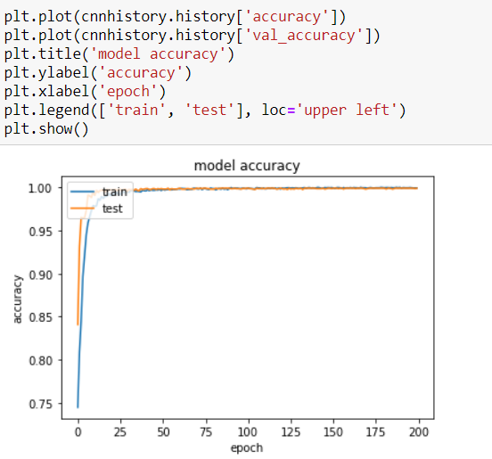
LAST OR 200th EPOCH
accuracy: 99.90%

Slide 23
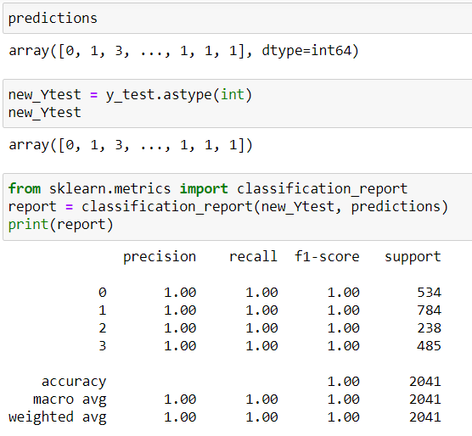
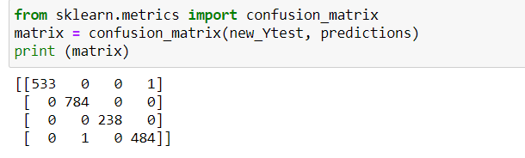
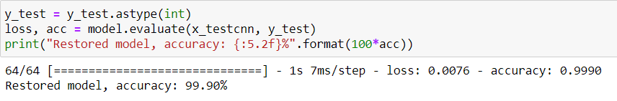
Confusion matrix
Accuracy came out to be 99.90%

Slide 24
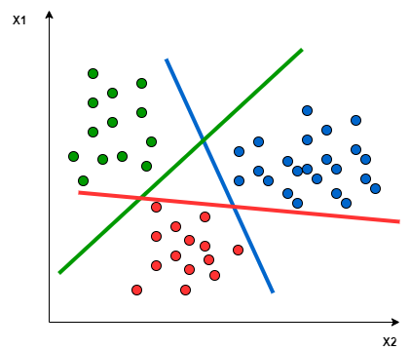
Support vector machine(SVM)
Support vector machines (SVMs) are powerful yet flexible supervised machine learning algorithms which are used both for classification and regression. But generally, they are used in classification problems
Working of SVM
An SVM model is basically a representation of different classes in a hyperplane in multidimensional space. The hyperplane will be generated in an iterative manner by SVM so that the error can be minimized. The goal of SVM is to divide the datasets into classes to find a maximum marginal hyperplane (MMH).
First, SVM will generate hyperplanes iteratively that segregates the classes in best way.
Then, it will choose the hyperplane that separates the classes correctly.

Slide 25
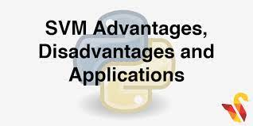
Pros and Cons of SVM Classifiers
Pros of SVM classifiers
SVM classifiers offers great accuracy and work well with high dimensional space. SVM classifiers basically use a subset of training points hence in result uses very less memory.
Cons of SVM classifiers
They have high training time hence in practice not suitable for large datasets. Another disadvantage is that SVM classifiers do not work well with overlapping classes.

Slide 26
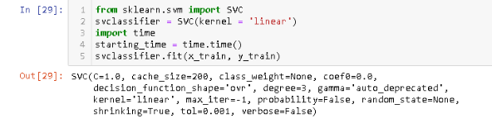
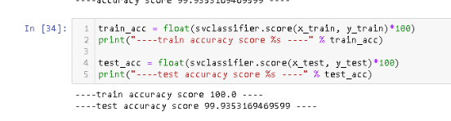
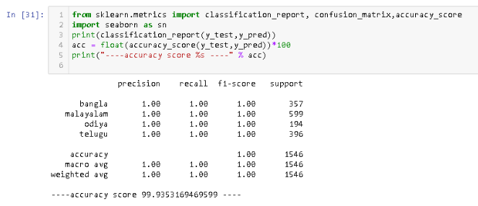
Accuracy came out to be 99.93%

Slide 27
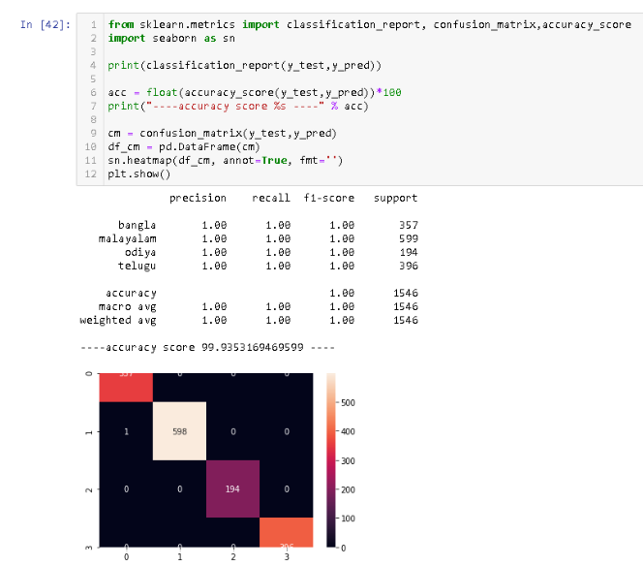
CONFUSION MATRIX

Slide 28

PREDICTIONS
After tuning the Model, tested it out by model by predicting the background using the testing data, for that Model is loaded again to predict the data
MLP: Accuracy came out to be 99.94%
CNN: Accuracy came out to be 99.90%
SVM:Accuracy came out to be 99.93%

Slide 29
Future of this model
In the future this model can be used in accent conversion and person infront of you feels some similarity between u and the machine
The following types of people may find this interesting:
Actors who need to learn an accent and does not know whether successful or not.
Speech pathologists
Anyone who finds foreign accent to be interesting.

Slide 30
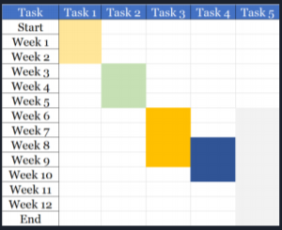
Project timeline:
TASK 1 Research about the project
TASK 2 Exploratory Data Analysis and Cleaning
TASK 3 Using various methods to accurately predict region using English accent
TASK 4 Collection & Representation of Data found
TASK 5 Proper Documentation & Integration Gantt Chart :
Gantt Chart :
TASK 2
TASK 4
TASK 1
TASK 3
TASK 5

Slide 31
THANK YOU

